Slide 1


Installing and getting started with R
Scott Ferson, School of Engineering, University of Liverpool, UK
Society for Risk Analysis Annual Meeting
© 2019 Scott Ferson

Slide 2
Downloading R
If you’re using Windows, download R from
https://cloud.r-project.org/bin/windows/base/R-4.1.2-win.exe
Open and run the self-extracting installation file
Invoke R from the list of recently added programs on the start menu
You can also navigate to https://www.r-project.org/ or just google ‘R’ and follow steps in next 8 slides

Slide 3


Slide 4
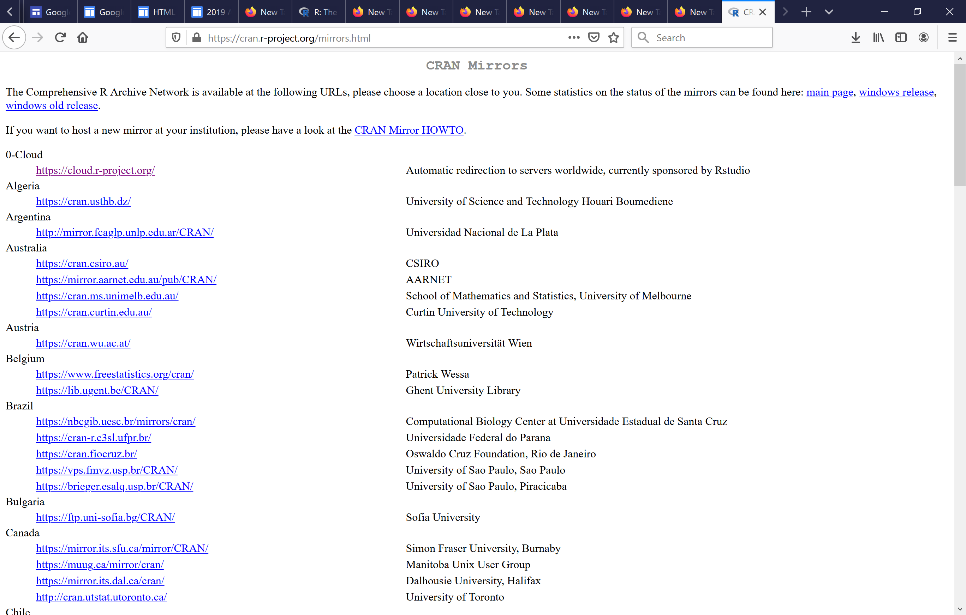

Slide 5
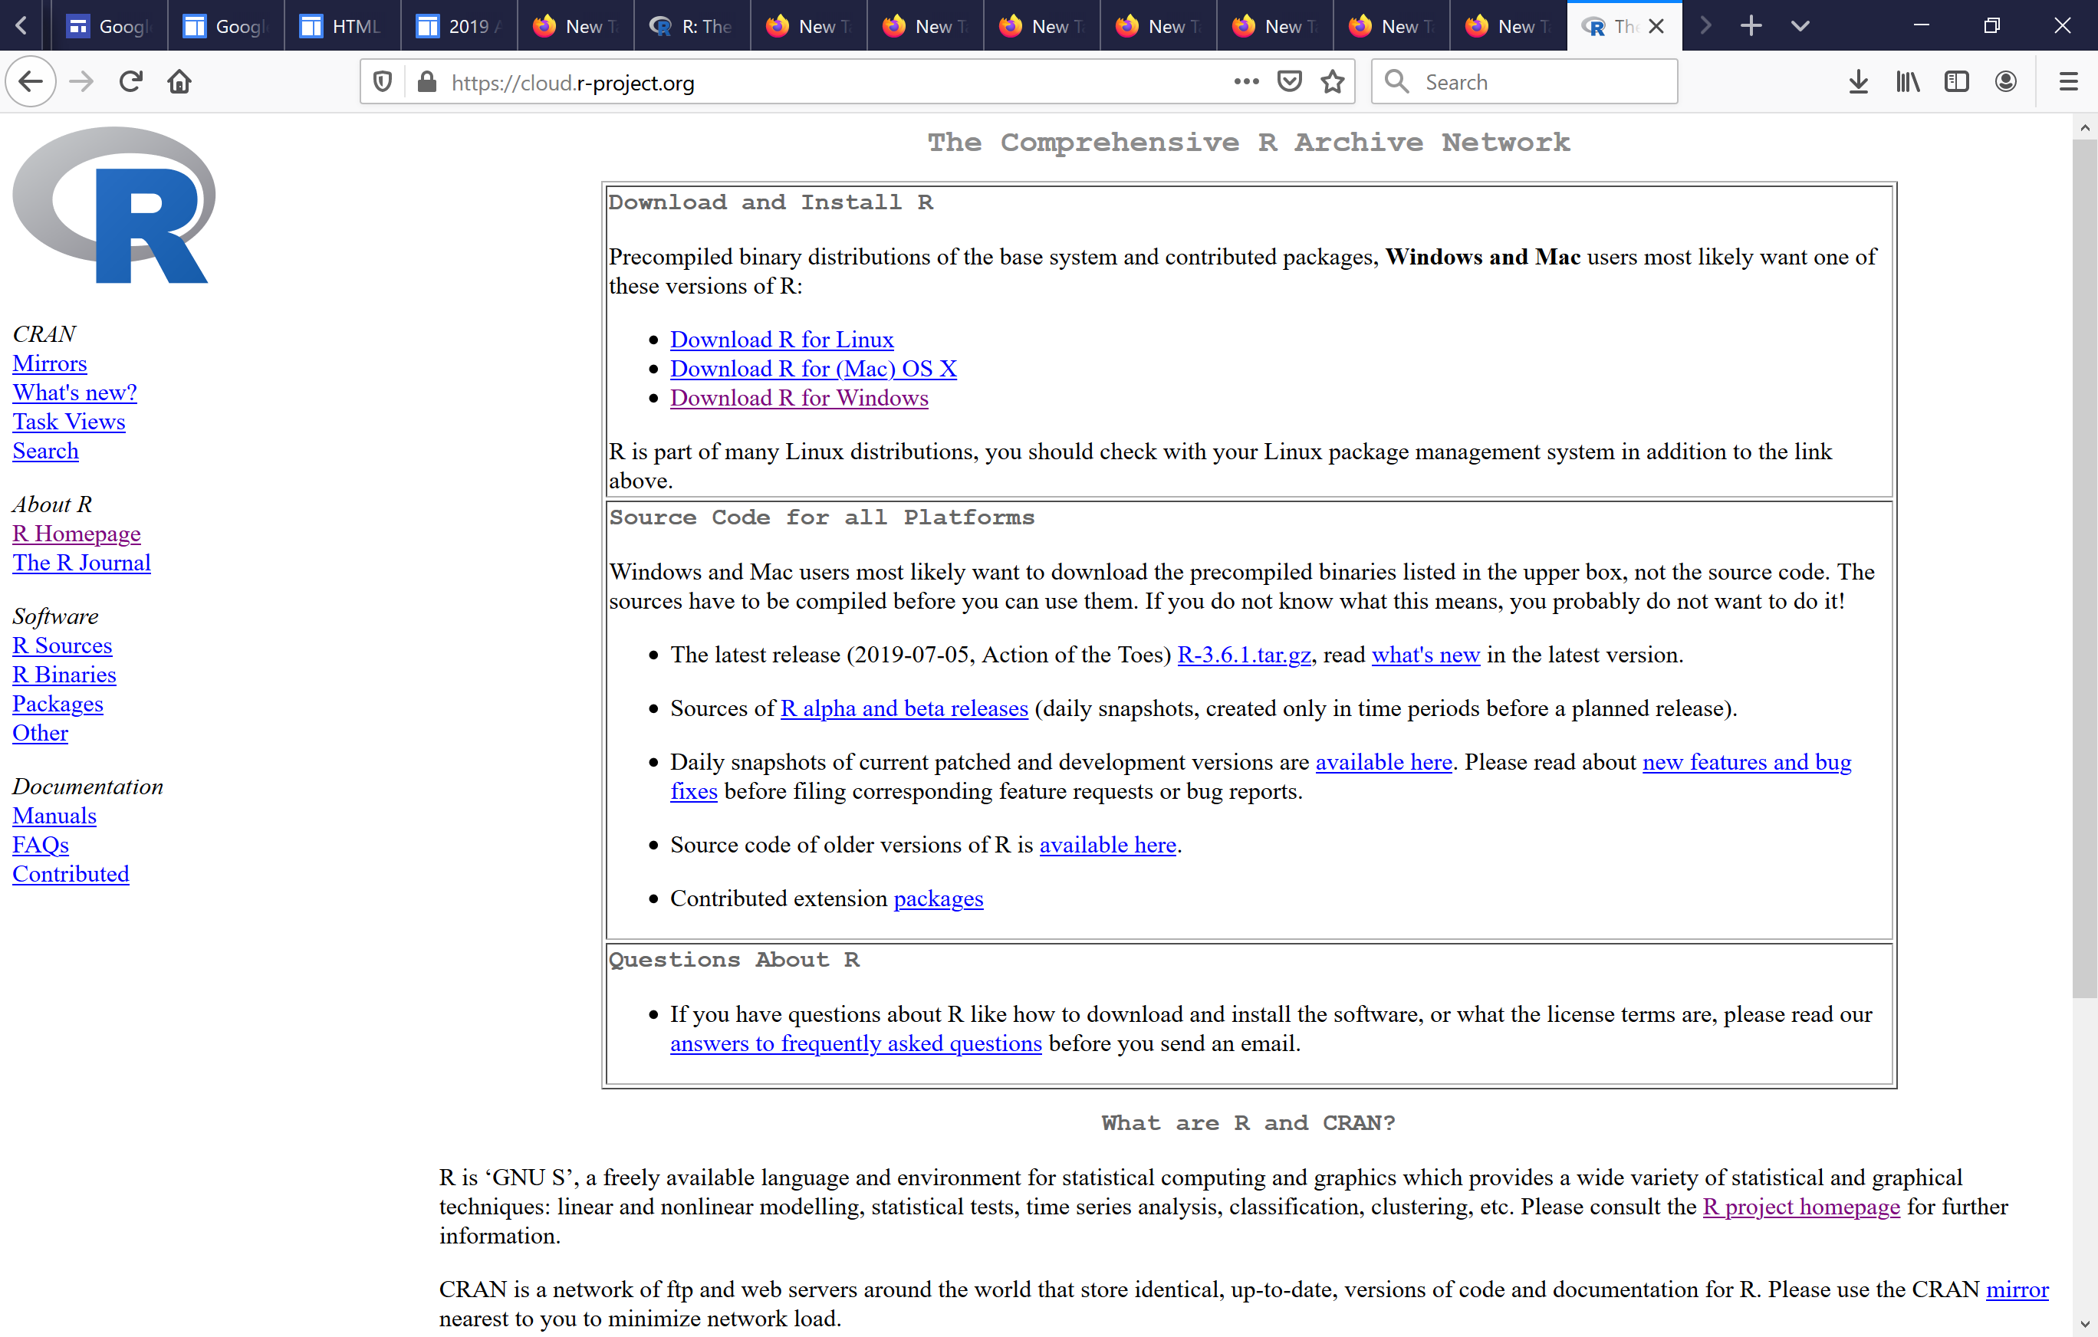
or download the Mac version

Slide 6
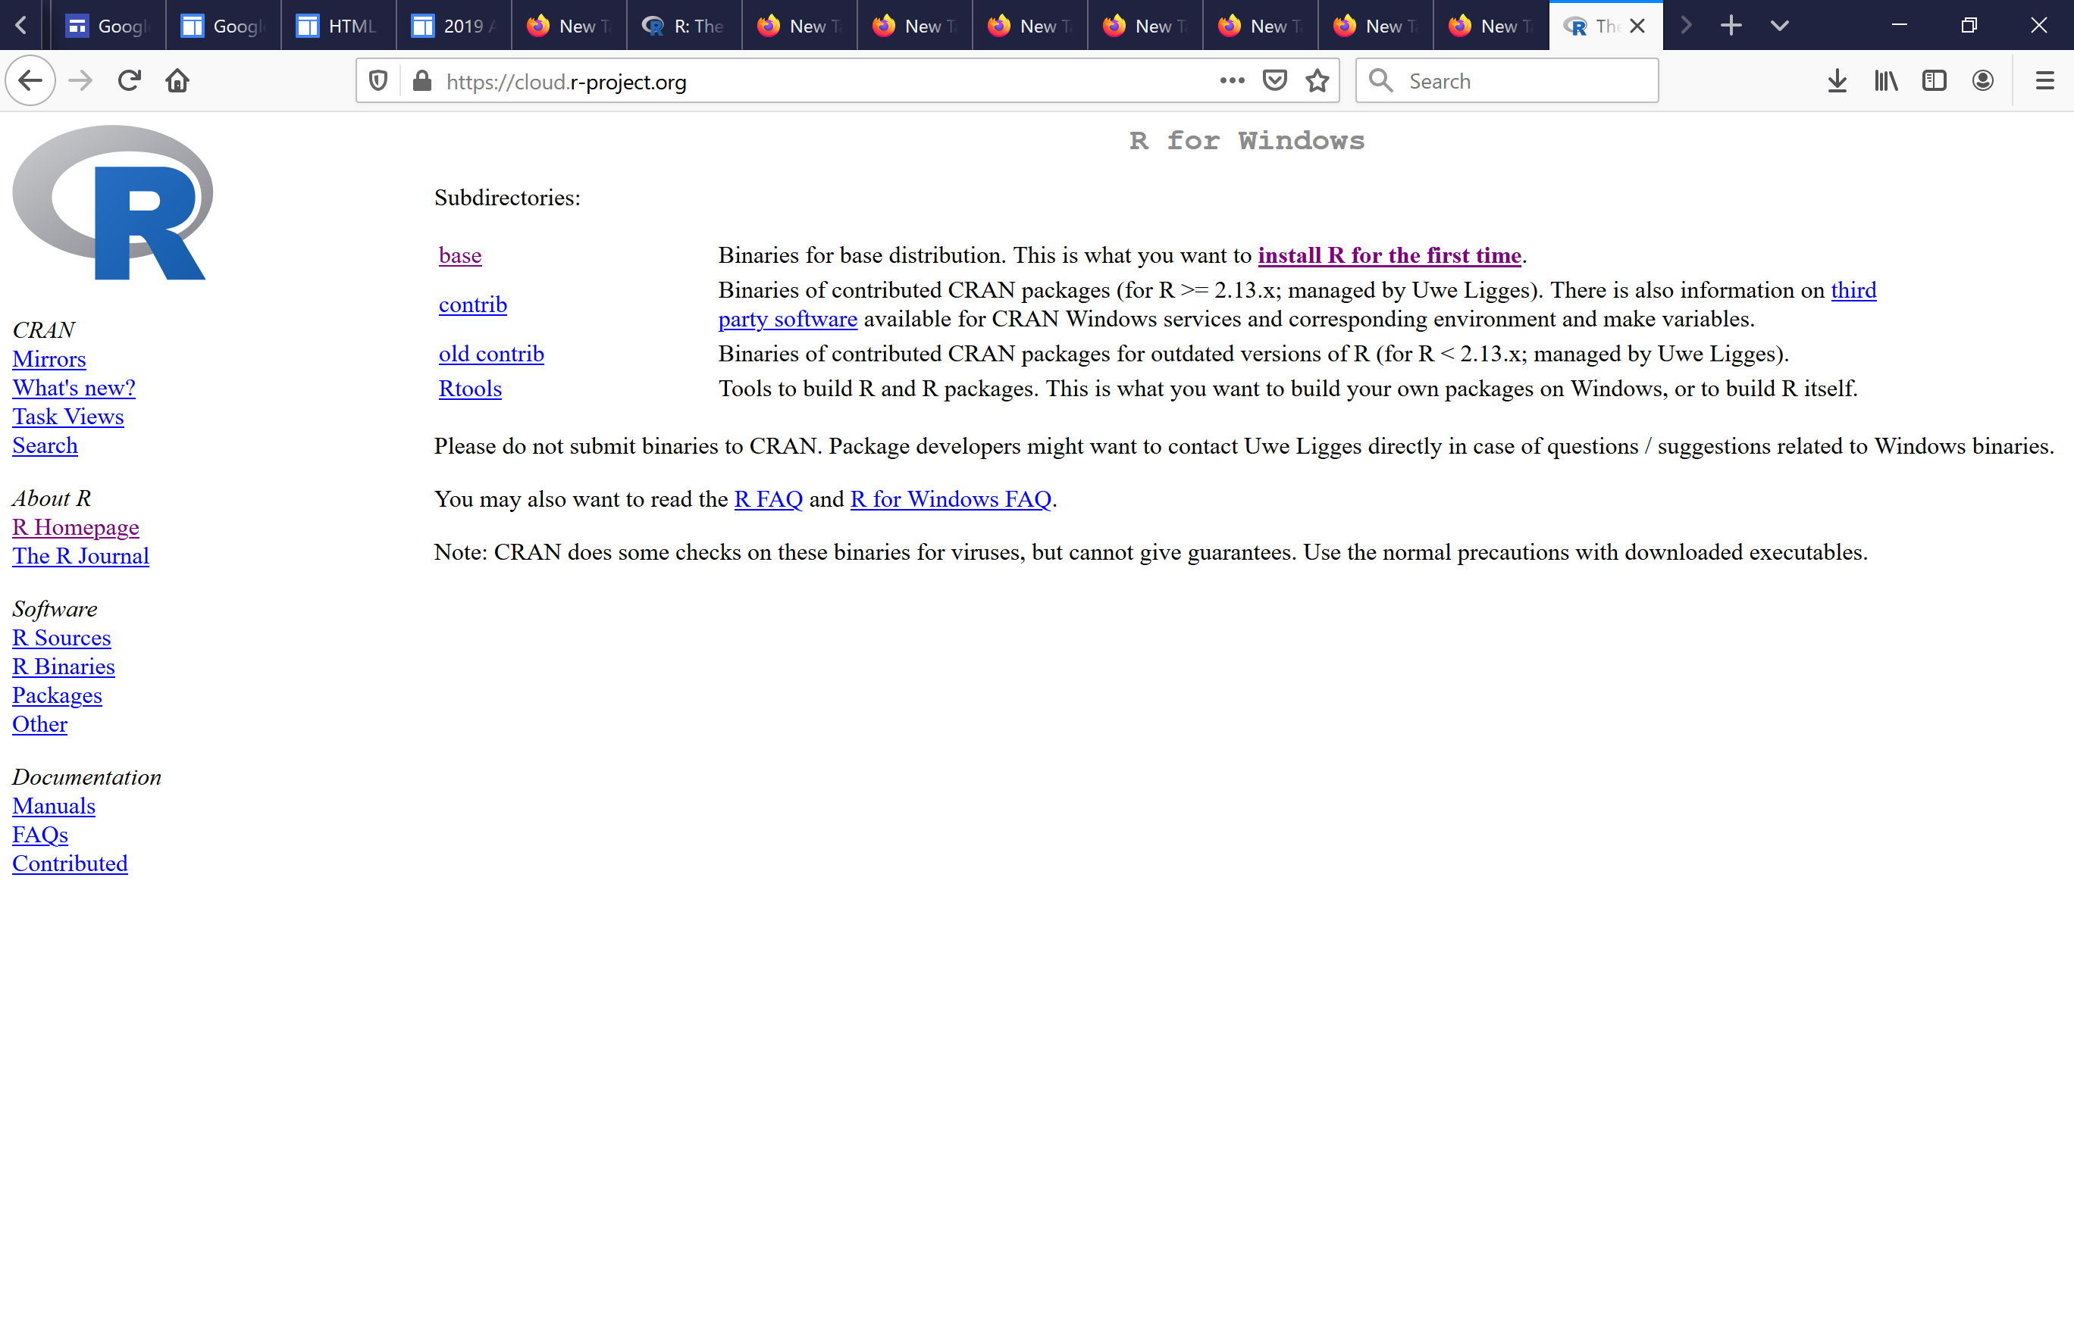

Slide 7
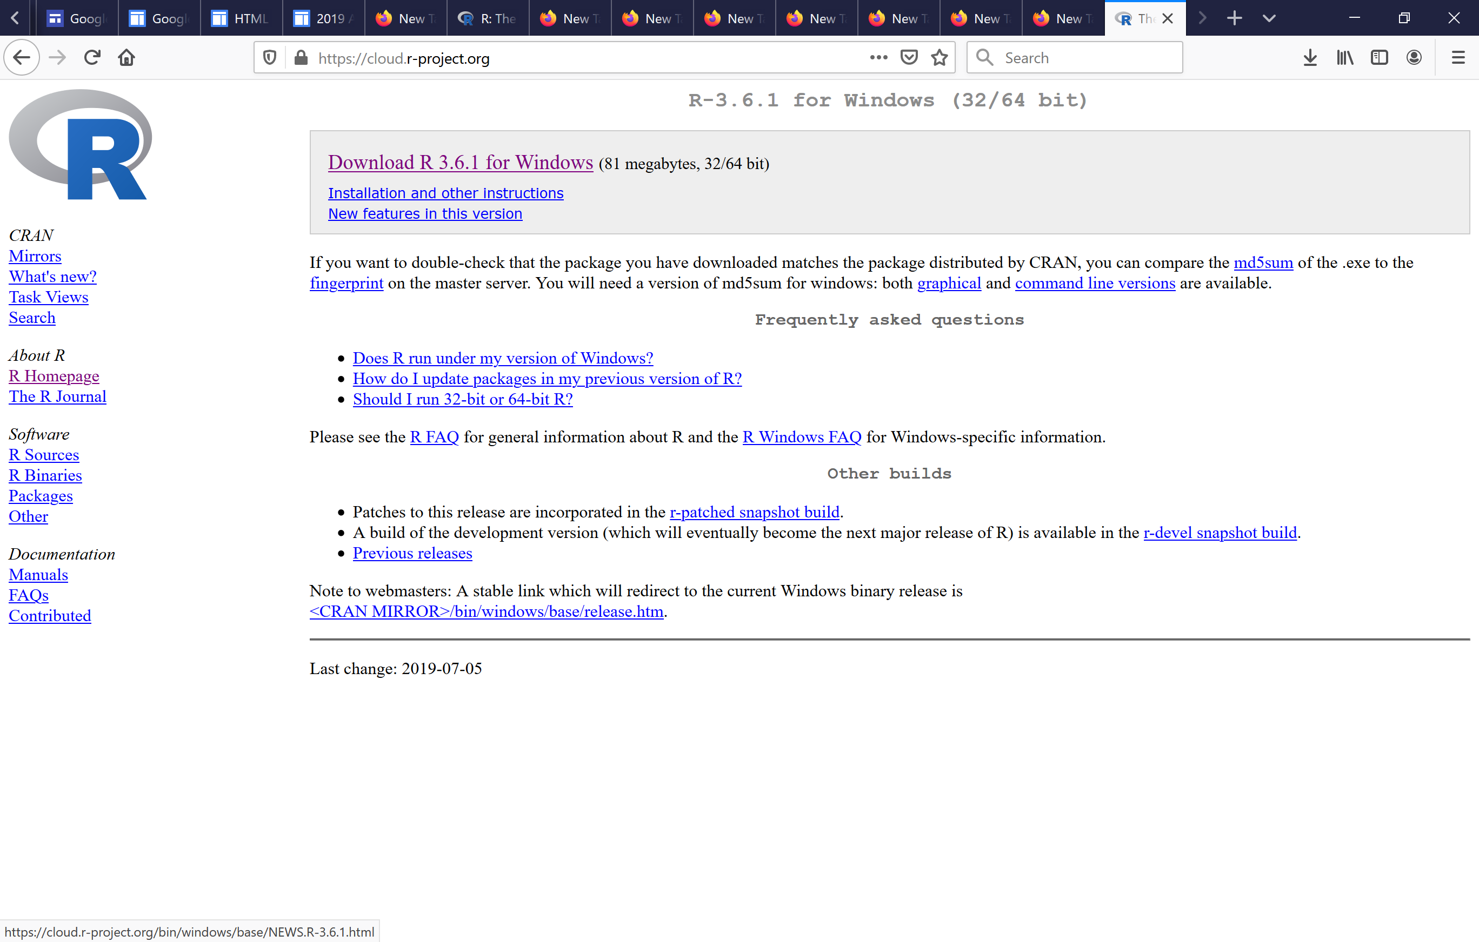

Slide 8
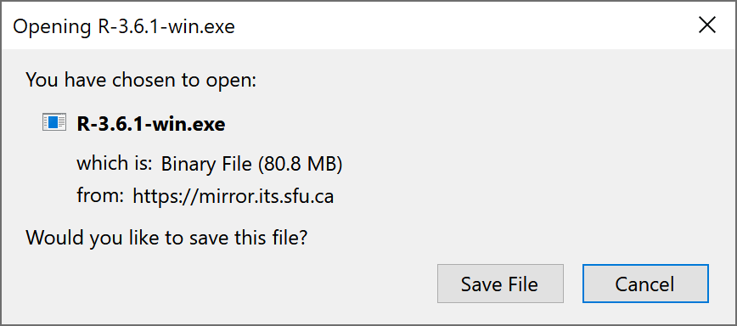

Slide 9
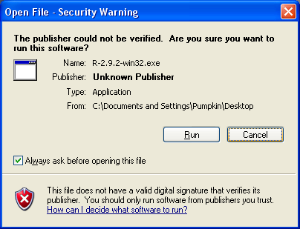
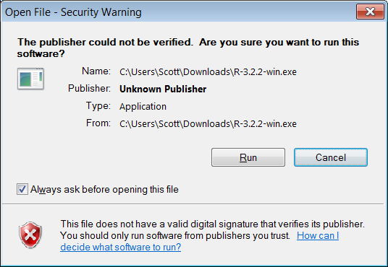

Slide 10
Choose several installation details
You can pretty safely accept all the defaults
Click on any Okay, Next or Finish buttons
To invoke R, open the Start menu and select it from the Recently Added list

Slide 11
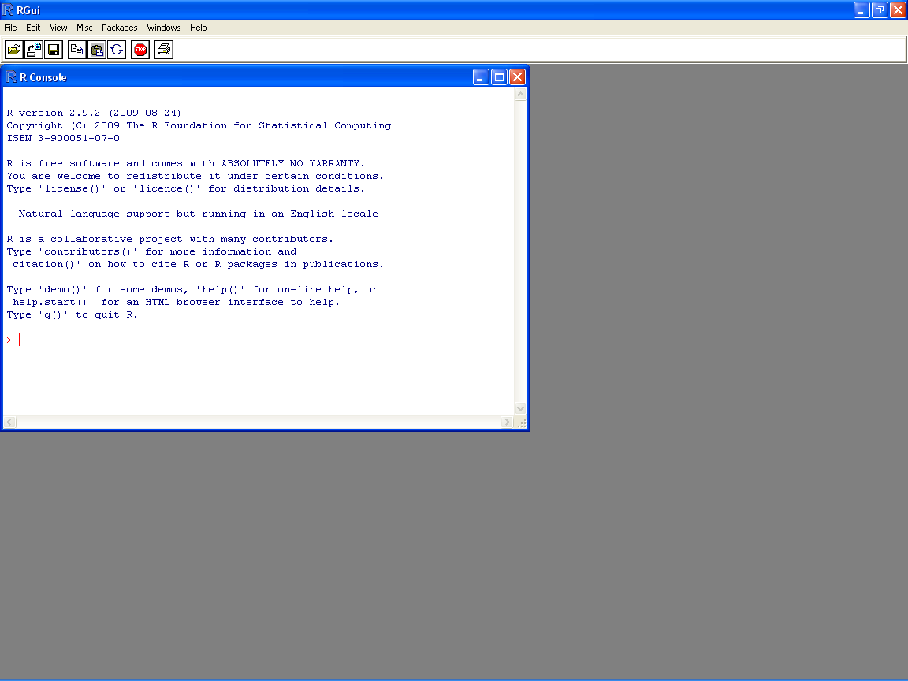
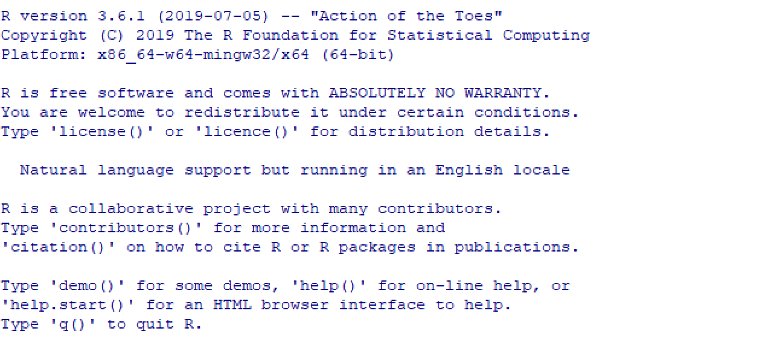
Inside R, you can enter commands and expressions
Your input is in red; its output is blue

Slide 12
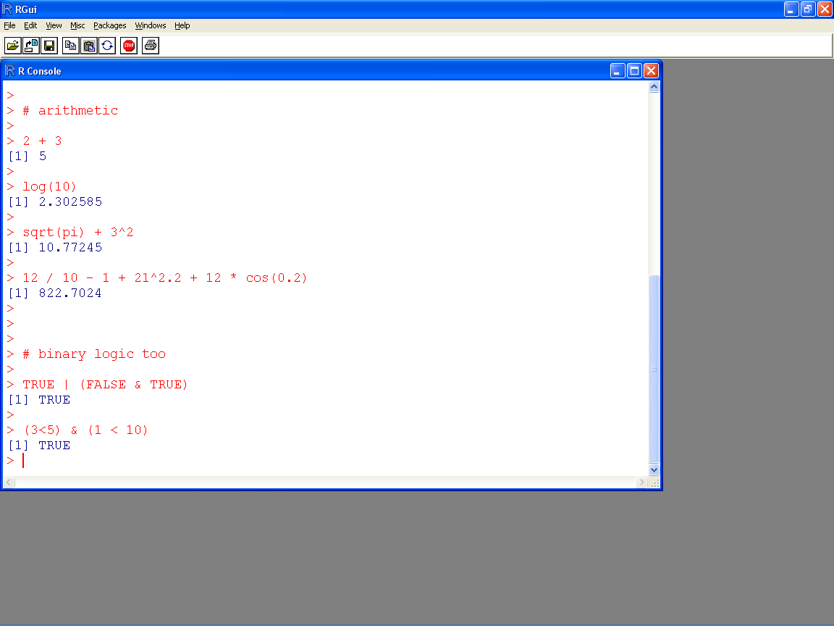
← anything after a hash tag (#) is a comment

Slide 13
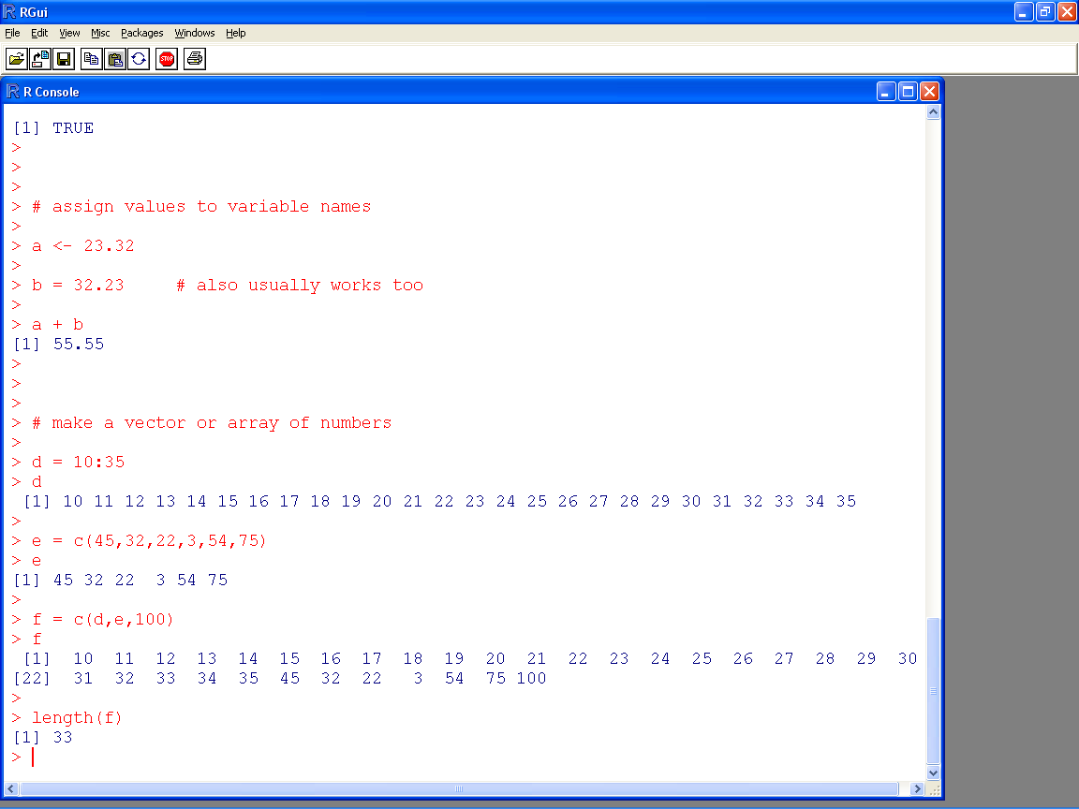

Slide 14
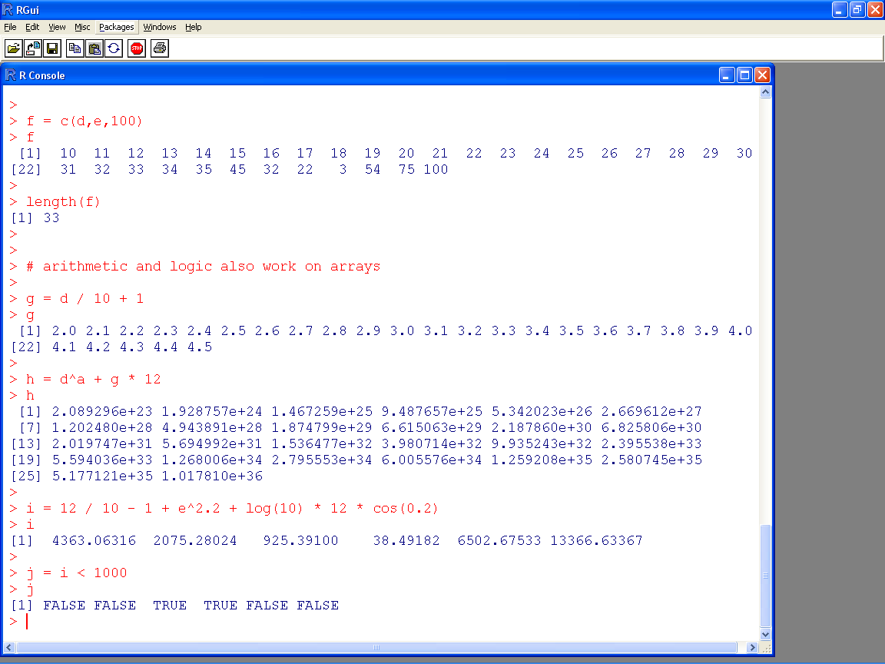

Slide 15
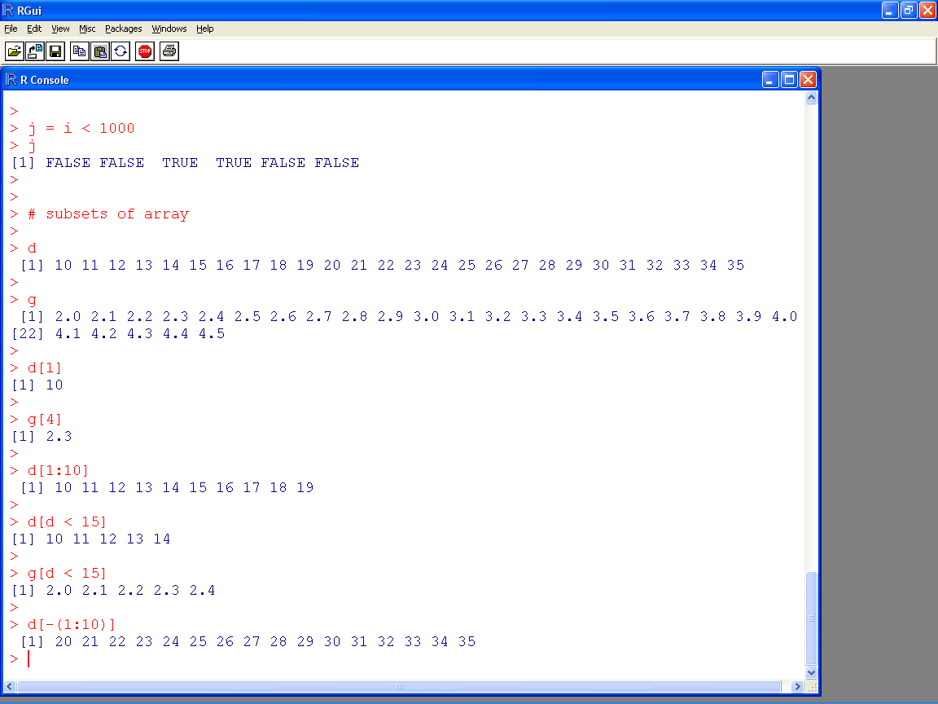

Slide 16
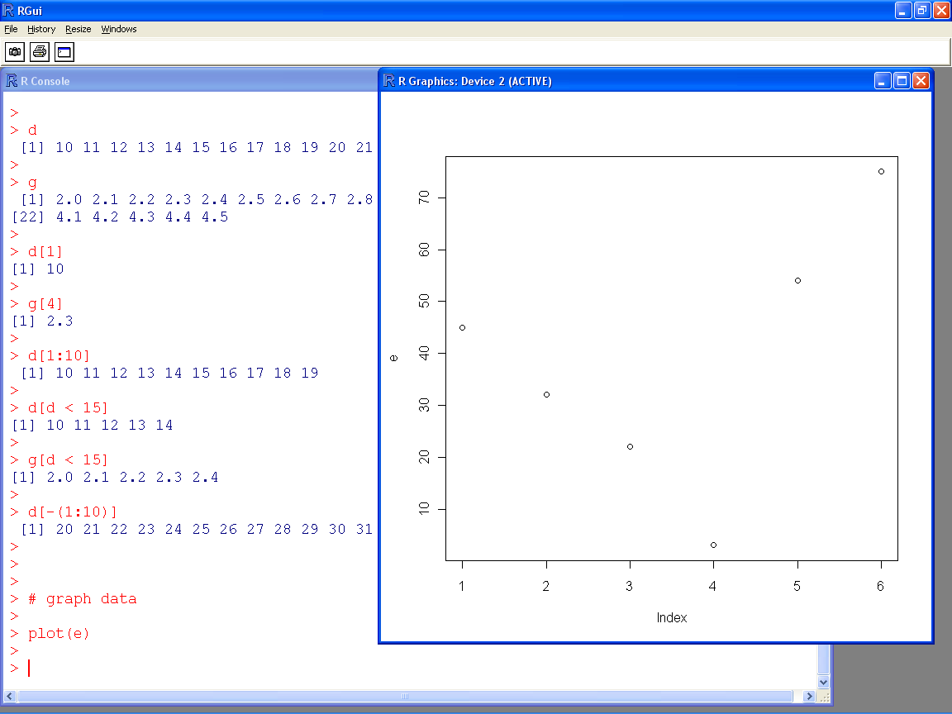

Slide 17
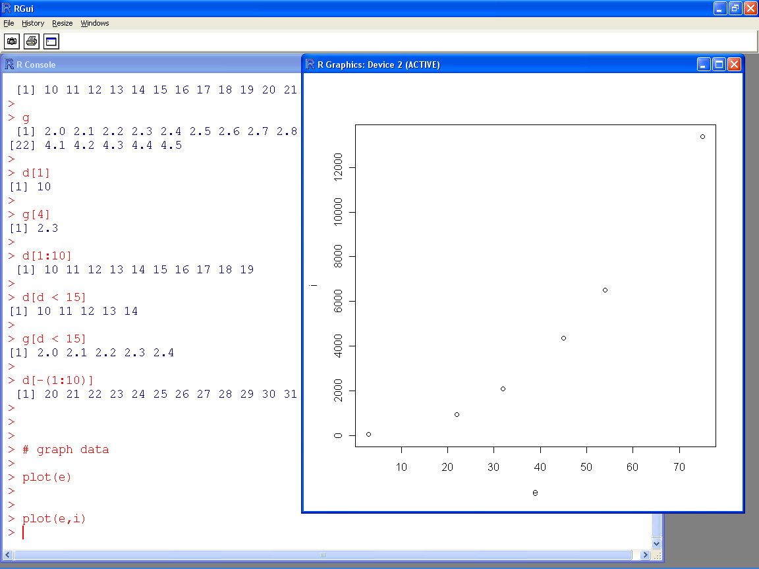

Slide 18
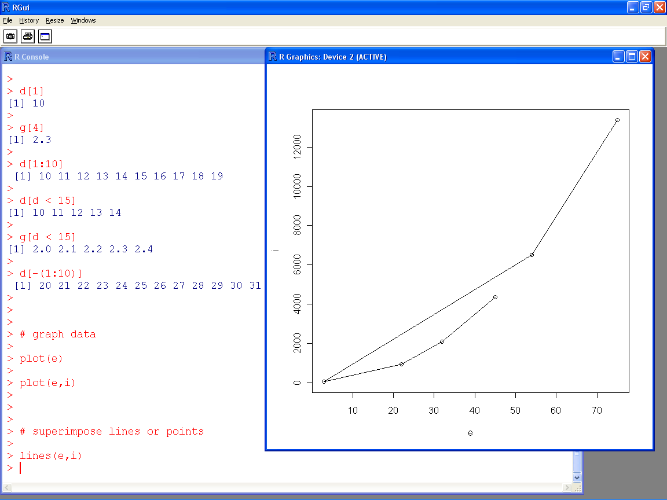

Slide 19
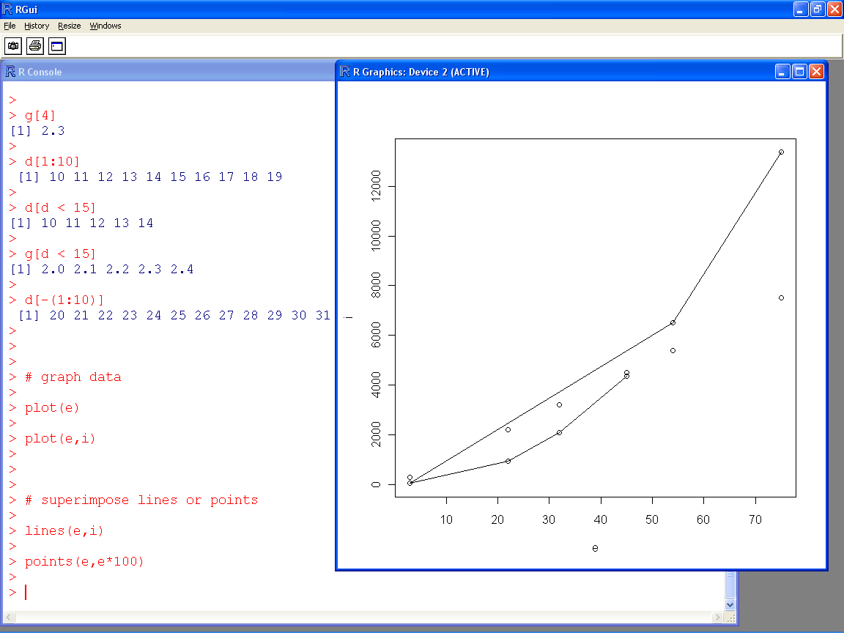

Slide 20
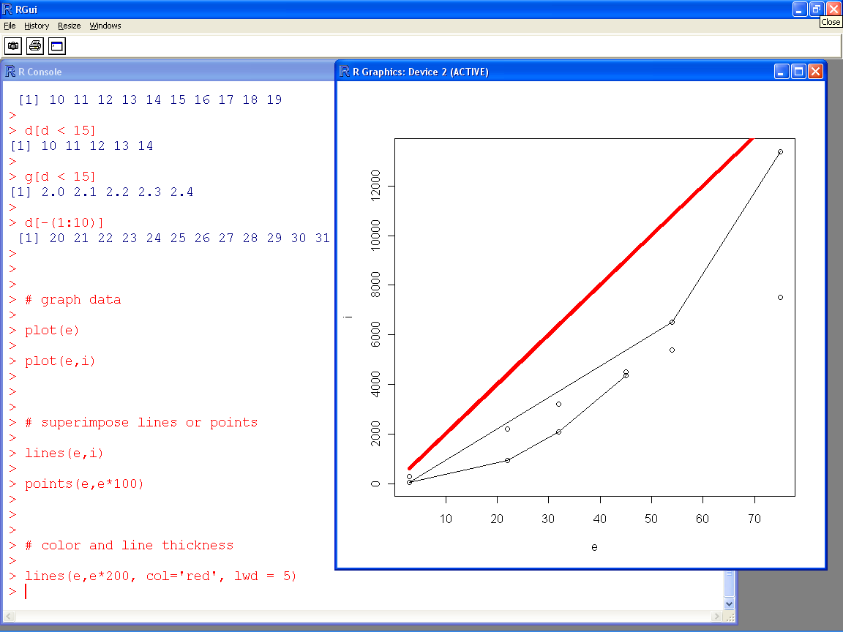

Slide 21
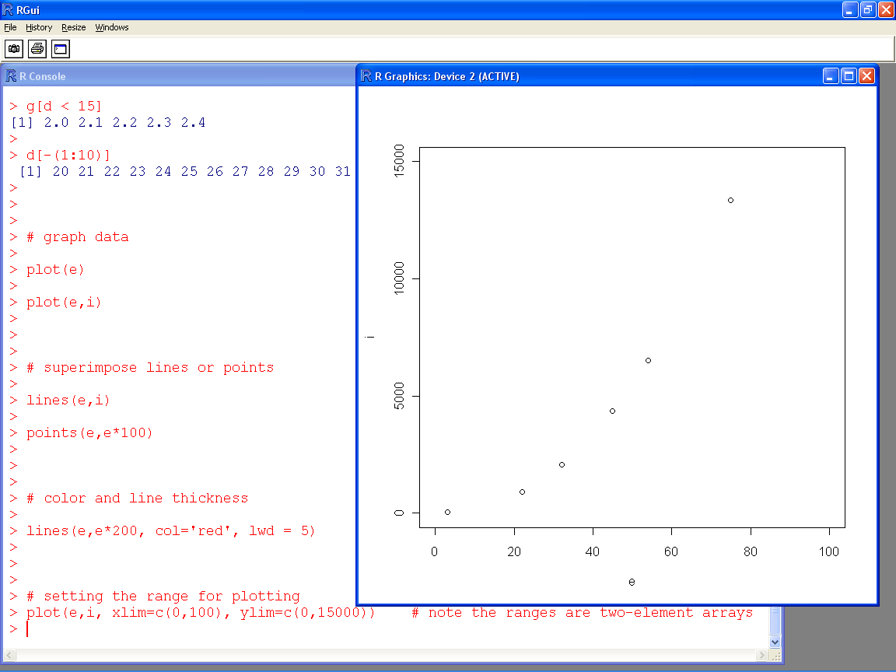

Slide 22
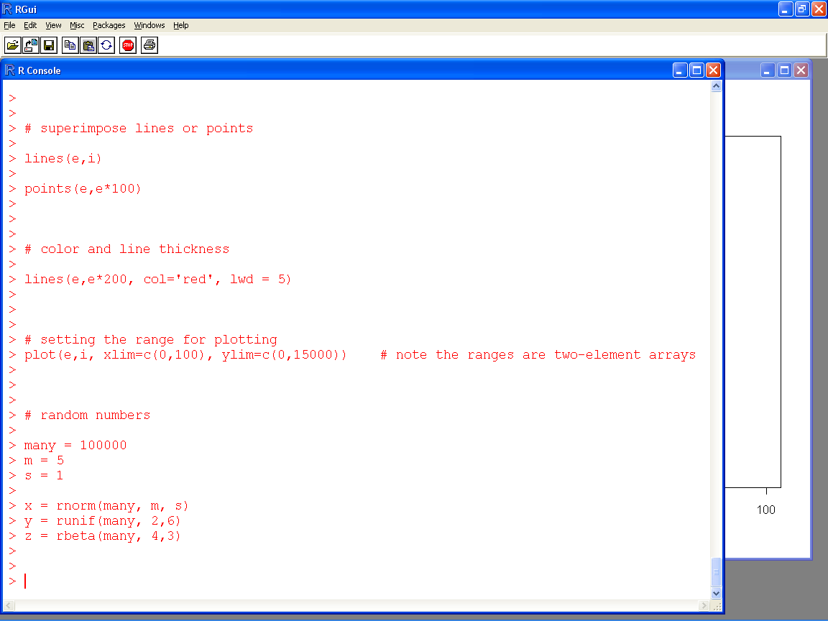

Slide 23
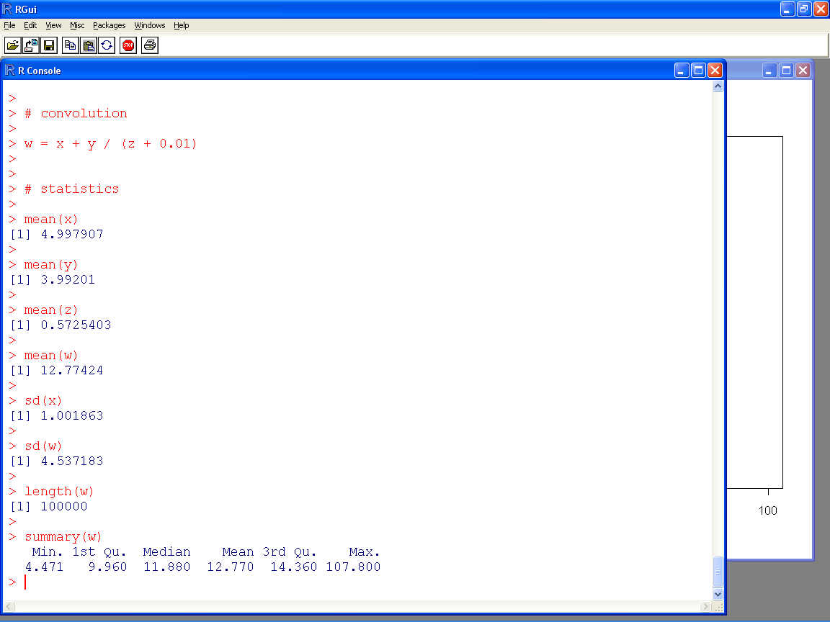

Slide 24
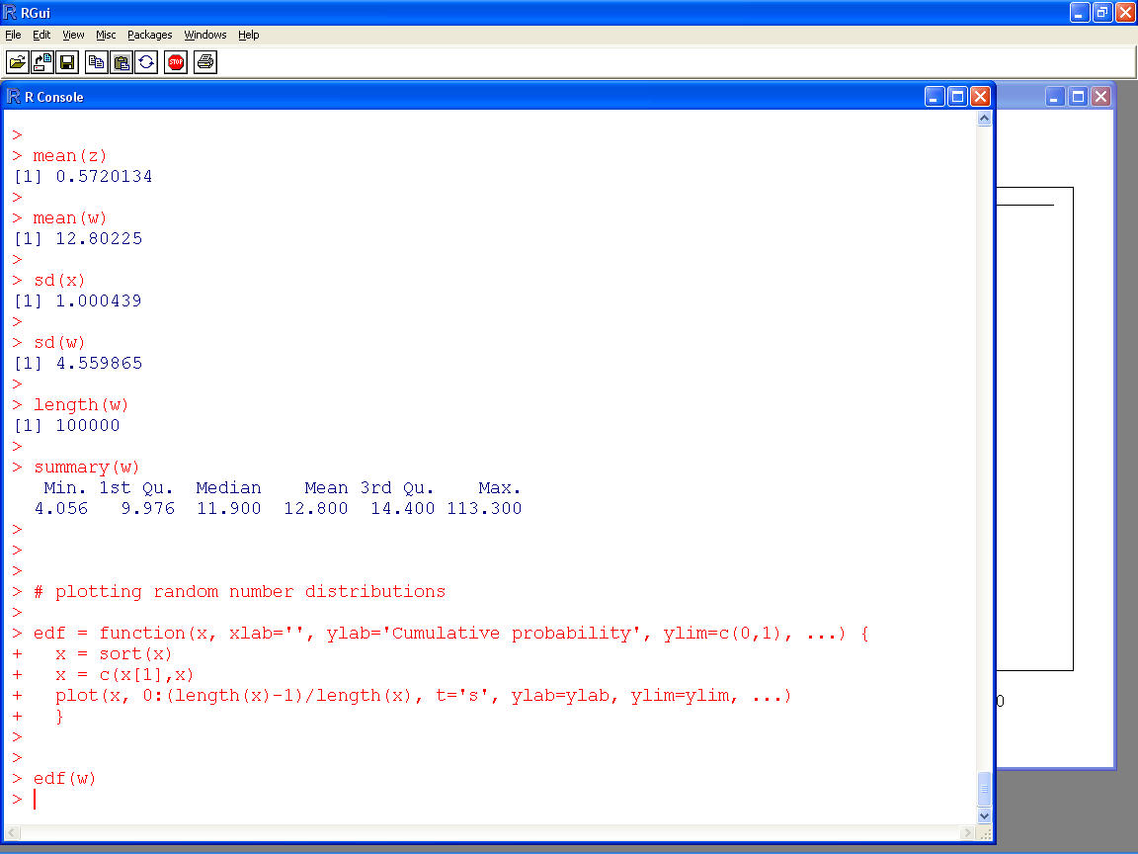

Slide 25
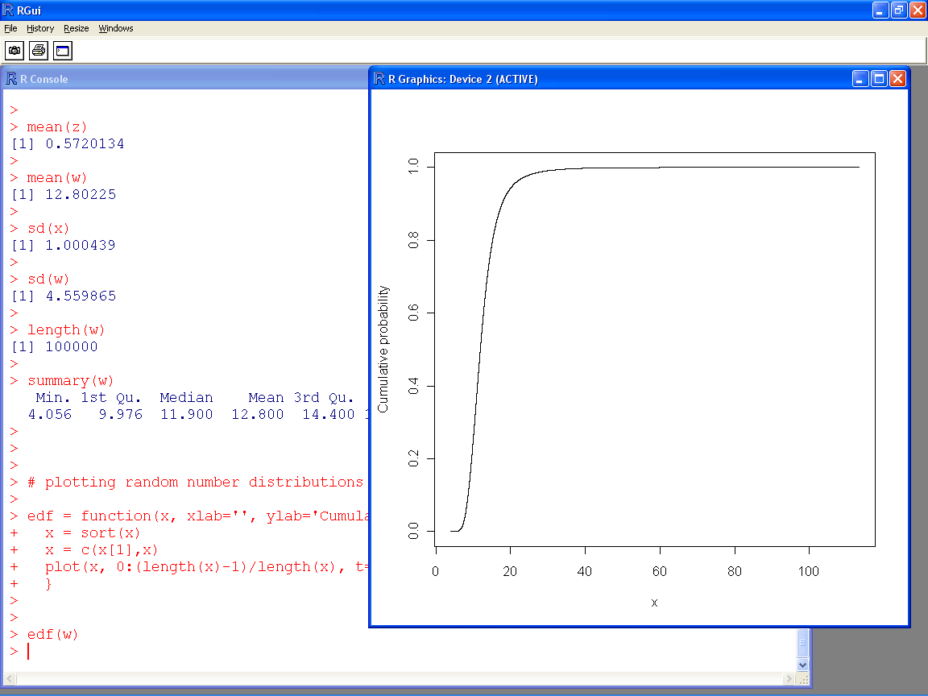

Slide 26
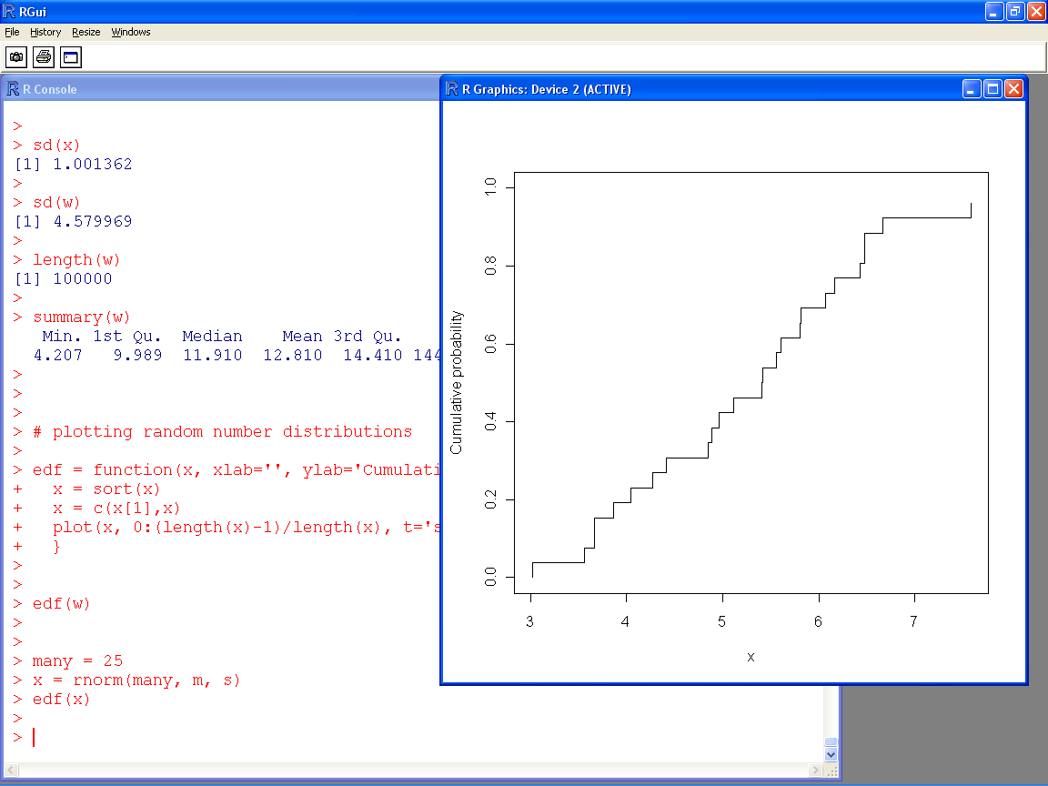

Slide 27
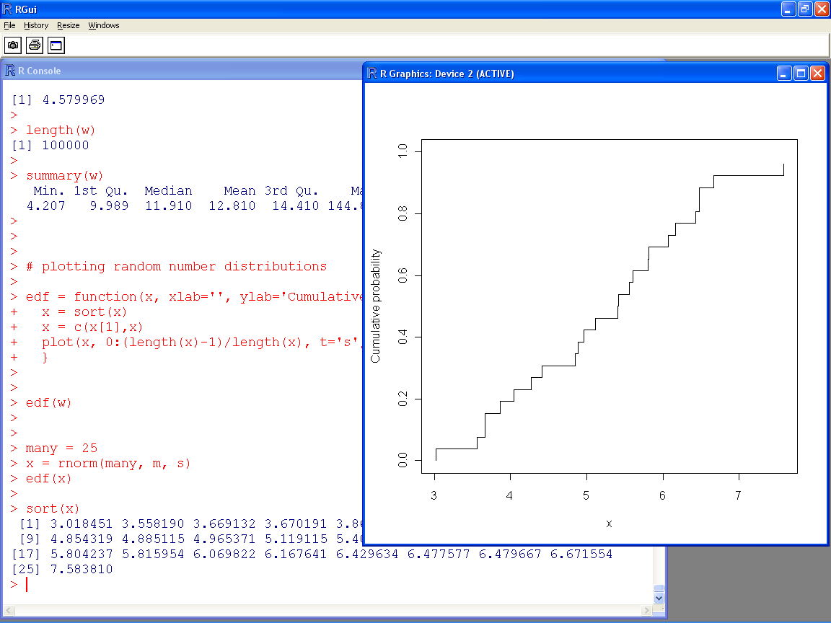

Slide 28
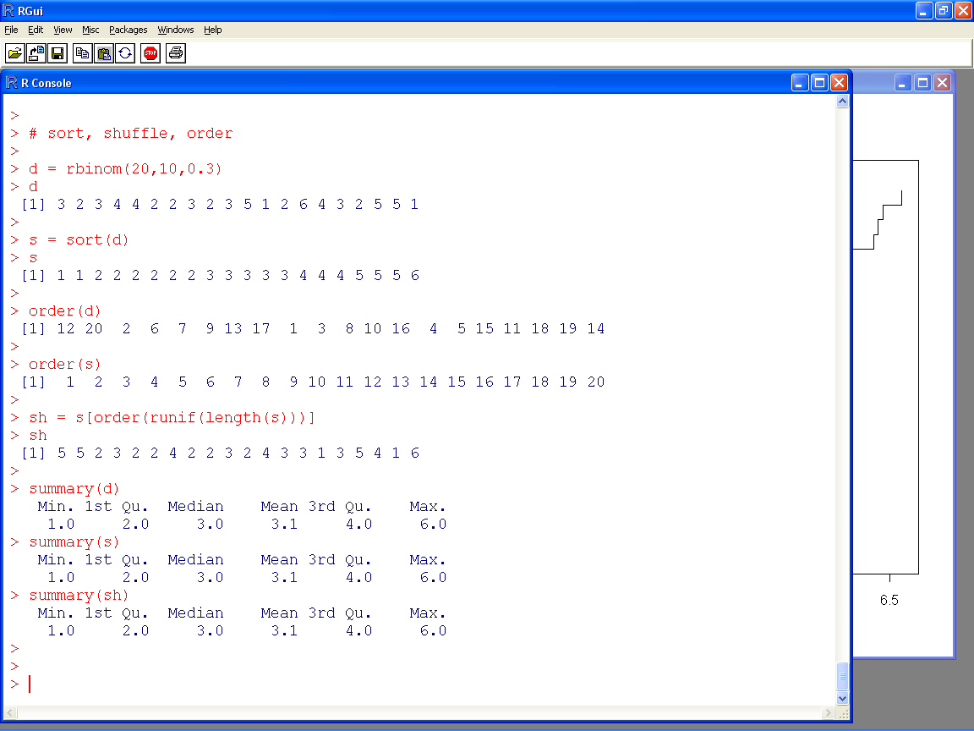

Slide 29
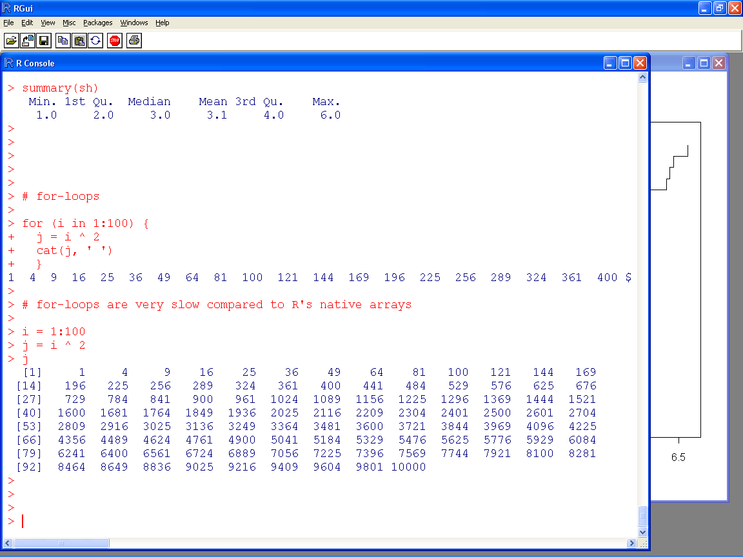

Slide 30
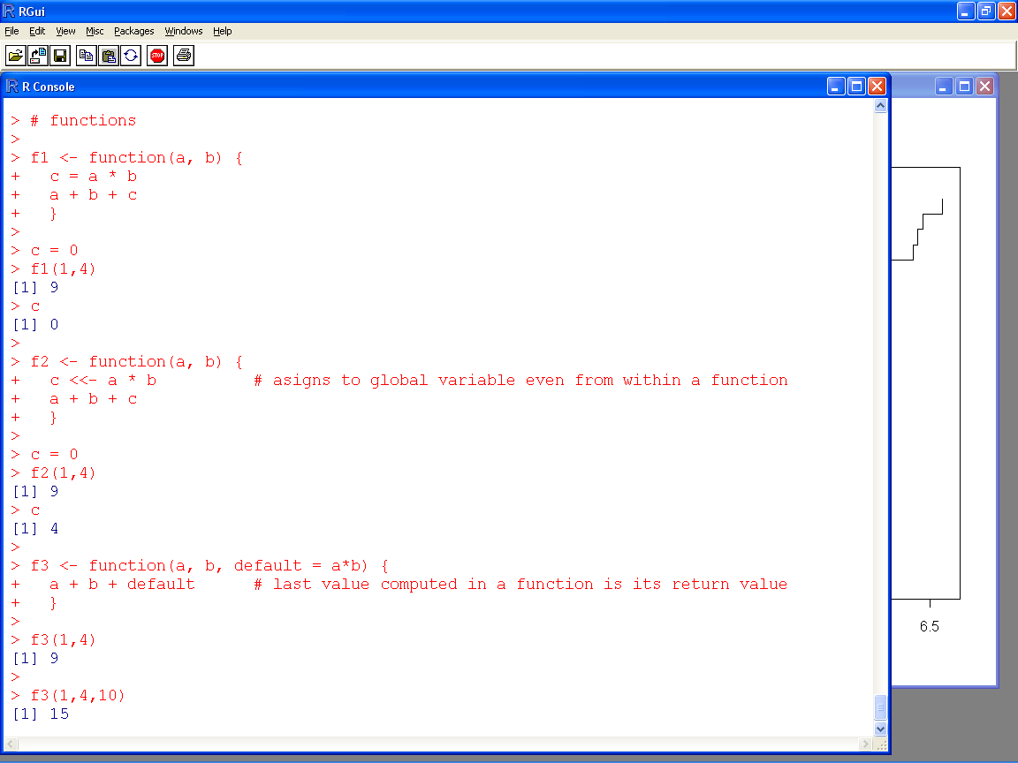

Slide 31
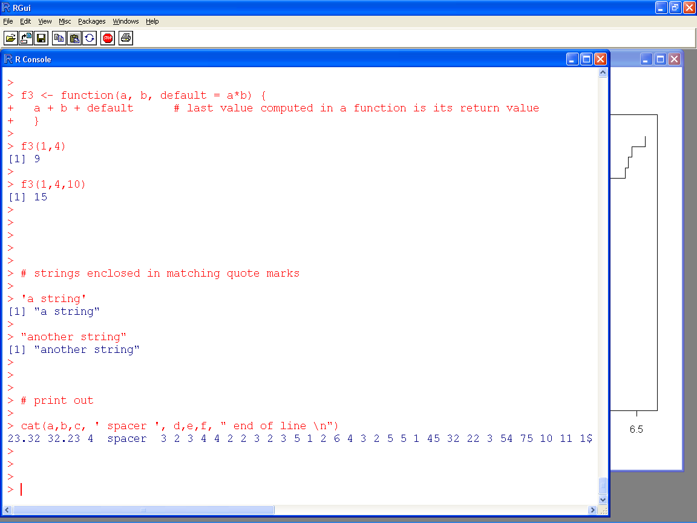

Slide 32
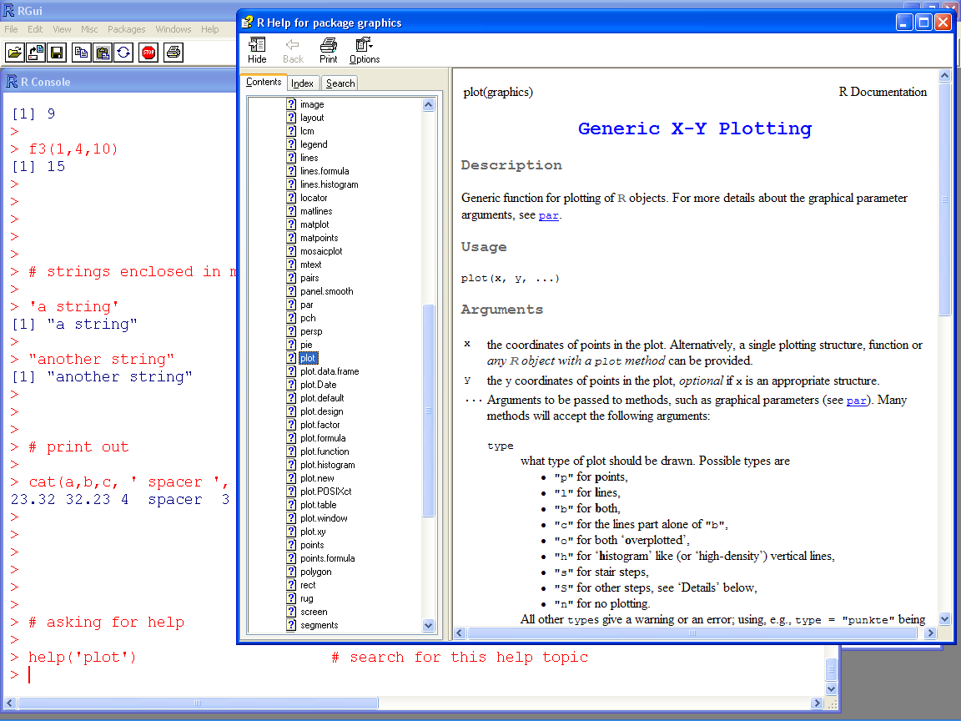

Slide 33
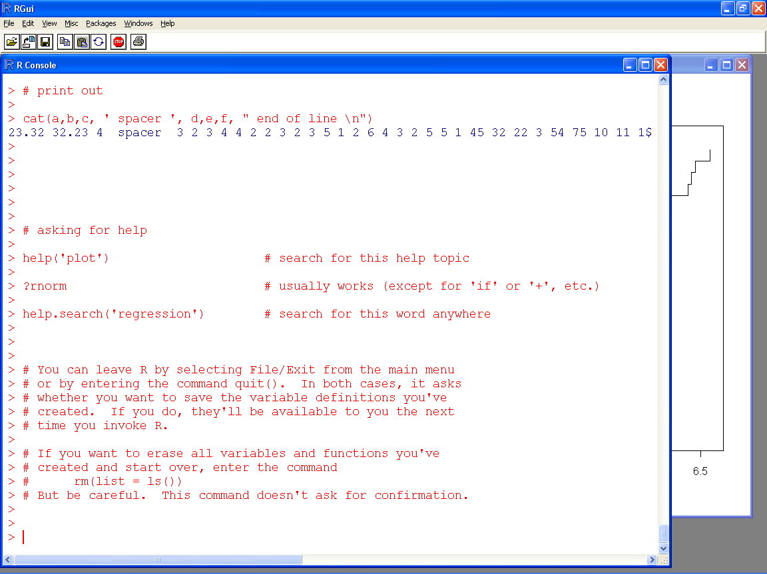

Slide 34
Installing libraries we’ll need
Click Packages / Install package(s)…, select any CRAN mirror, and click OK
After a pause, a list of packages will pop up
Select the package MASS, and click OK
You may wish to install other packages

Slide 35
Leaving R
To leave R click File / Exit from the main menu or enter the command quit()
R will ask whether you want to save your work
If you do, your variables and functions will be available the next time you invoke R
To erase all variables and functions and start fresh, enter the command rm(list = ls())

Slide 36
Installing sra.r

Slide 37
Install the sra.r Monte Carlo library
If you left R, invoke it again
Enter rm(list = ls()) to clear its memory
Click File / Source R code on the main menu
Locate and Open the file sra.r
You’ll get the message ":sra> library loaded"

Slide 38
Testing the sra.r installation
Optional
You don’t need to test the installation. Just skip to the next slide
Start a new instance of R, and enter the command rm(list = ls())
Click File / Source R code on the main menu; find and Open the file sra.r
The R Console will display something like
> source("C:\\Users\\workshop sra\\sra.r")
:sra> library loaded
Enter plot(runif(100)) which will open a plot window with random points
Click History / Recording on the main (if History is missing, click the plot)
Click on the R Console, click File / Open script, and find and Open test sra.r
Press Ctrl-A to select all its text, then press Ctrl-C to copy it to the clipboard, and close the R Editor window
Click on the R Console, and press Ctrl-V to paste the text into the R Console for execution
Click on the plot window, and press PgUp and PgDn to scroll through graphical results of the test calculations
There should be no error messages on the R Console

Slide 39
sra.r Monte Carlo library
a = normal(5,1)
a
b = uniform(2,3)
b
a + b

Slide 40
Generalized convolutions
a * b
pmin(a,b)
c = a + b * beta(2,3) / a
c
mean(c)

Slide 41
Functionality in sra.r
Distributions
bernoulli, beta, betapert, binomial, cauchy, chi, chisquared, delta, dirac, discreteuniform, exponential, exponentialpower, extremevalue, F, fishersnedecor, fishertippett, fisk, frechet, gamma, gaussian, geometric, gev, generalizedpareto, gumbel, histogram, inversegamma, laplace, logistic, loglogistic, lognormal, logtriangular, loguniform, MEdiscretemean, MEdiscreteminmax, MEmeansd, MEmeanvar, MEminmax, MEminmaxmean, MEminmaxmeansd, MEminmaxmeanvar, MEminmean, MEquantiles, mc (pointlist), negativebinomial, normal, N, pareto, pascal, powerfunction, poisson, quantiles, rayleigh, reciprocal, shiftedloglogistic, skewnormal, student, trapezoidal, triangular, uniform, U, weibull
Operators, functions and commands
+, *, -, /, ^, abs, acos, and, asin, atan, atan2, ceiling, complement, cor, cos, cut, edf, exp, fivenum, floor, iqr, IQR, left, lines, log, mean, median, mixture, negate, not, oppositeconv.mc, or, percentile, perfectconv.mc, plot, pmax, pmin, prob, quantile, random, reciprocate, right, round, samedistribution, sd, show, sign, sin, specific, sqrt, summary, tan, trunc, var

Slide 42
Monte Carlo in sra.r
Output
<enter variable name>, plot, lines, show, summary
Characterize
mean, sd, var, median, quantile, fivenum, left, right, prob, cut, percentile, iqr, random, range
Compute
exp, log, sqrt, abs, round, trunc, ceiling, floor, sign, sin, cos, tan, asin, acos, atan, atan2, reciprocate, negate, +, -, *, /, pmin, pmax, ^, and, or, not, mixture, smin, smax, complement

Slide 43
Monte Carlo in sra.r
Construct
normal, etc.
histogram
quantiles
MM <tab> <tab>
ME <tab> <tab>
ML <tab> <tab>
Supported named distributions
bernoulli, beta (B), binomial (Bin), cauchy, chi, chisquared, delta, dirac, discreteuniform, exponential, exponentialpower, extremevalue, F, f, fishersnedecor, fishertippett, fisk, frechet, gamma, gaussian, geometric, generalizedextremevalue (GEV), generalizedpareto, gumbel, histogram, inversegamma, laplace, logistic, loglogistic, lognormal (L), logtriangular, loguniform, negativebinomial, normal (N), pareto, pascal, powerfunction, poisson, quantiles, rayleigh, reciprocal, shiftedloglogistic, skewnormal (SN), student, trapezoidal, triangular (T), uniform (U), weibull

Slide 44
Installing pba.r

Slide 45
Install the pba.r probability box library
If you left R, invoke it again
Enter rm(list = ls()) to clear its memory
Click File / Source R code on the main menu
Locate and Open the file pba.r
You’ll get the message ":pba> library loaded"

Slide 46
Die-hard RStudio users
If, against advice, you must use RStudio…
File / Open file pbox.r
Source (Ctrl+Shift+S) pbox.r
Enter the instruction RStudio = TRUE

Slide 47
Testing the pba.r installation
Optional
You don’t need to test the installation. Just skip to the next slide
Start a new instance of R, and enter the command rm(list = ls())
Click File / Source R code on the main menu; find and Open the file pba.r
The R Console will display something like
> source("C:\\Users\\workshop sra\\pba.r")
:pba> library loaded
Enter plot(runif(100)) which will open a plot window with random points
Click History / Recording on the main (if History is missing, click the plot)
Click on the R Console, click File/Open script, and find and Open test pba.r
Press Ctrl-A to select all its text, then press Ctrl-C to copy it to the clipboard, and close the R Editor window
Click on the R Console, and press Ctrl-V to paste the text into the R Console for execution
Click on the plot window, and press PgUp and PgDn to scroll through graphical results of the test calculations
There should be no error messages on the R Console

Slide 48
pba.r probability bounds library
a = normal(5,1)
a
b = uniform(2, interval(3,4))
b
a + b

Slide 49
Generalized convolutions
a * b
a %*% b
c = a + weibull(8,1) * beta(2,3) / b
c
mean(c)

Slide 50
Probability bounds analysis in pba.r
Output
<enter variable name>, plot, lines, show, summary
Characterize
mean, sd, var, median, quantile, fivenum, left, right, prob, cut, percentile, iqr, random, range
Compute
exp, log, sqrt, abs, round, trunc, ceiling, floor, sign, sin, cos, tan, asin, acos, atan, atan2, reciprocate, negate, +, -, *, /, pmin, pmax, ^, and, or, not, mixture, smin, smax, complement

Slide 51
Probability bounds analysis in pba.r
Construct
<named distribution>
histogram
quantiles
pointlist
MM <tab> <tab>
ME <tab> <tab>
ML <tab> <tab>
CB <tab> <tab>
NV <tab> <tab>
Supported named distributions
bernoulli, beta (B), binomial (Bin), cauchy, chi, chisquared, delta, dirac, discreteuniform, exponential, exponentialpower, extremevalue, F, f, fishersnedecor, fishertippett, fisk, frechet, gamma, gaussian, geometric, generalizedextremevalue (GEV), generalizedpareto, gumbel, histogram, inversegamma, laplace, logistic, loglogistic, lognormal (L), logtriangular, loguniform, negativebinomial, normal (N), pareto, pascal, powerfunction, poisson, quantiles, rayleigh, reciprocal, shiftedloglogistic, skewnormal (SN), student, trapezoidal, triangular (T), uniform (U), weibull

Slide 52
The libraries don’t work together
After loading pba.r, the functions of sra.r will no longer work as they did before
After loading sra.r, the functions of pba.r will no longer work as they did before

Slide 53
Cheat sheet for R libraries
plot, lines, show, summary
mean, sd, var, median, quantile, left, right, prob, cut, percentile, iqr, random, range
exp, log, sqrt, abs, round, trunc, ceiling, floor, sign, sin, cos, tan, asin, acos, atan, atan2, reciprocate, negate, +, -, *, /, pmin, pmax, ^, and, or, not, mixture, smin, smax
sra.r
normal, etc.
histogram
quantiles
MM<tab><tab>
ME<tab><tab>
ML<tab><tab>
pba.r
normal, etc.
histogram
quantiles
pointlist
MM<tab><tab>
ME<tab><tab>
ML<tab><tab>
CB<tab><tab>
NV<tab><tab>
Supported named distributions
bernoulli, beta, binomial, cauchy, chi, chisquared, delta, dirac, discreteuniform, exponential, exponentialpower, extremevalue, f, fishersnedecor, fishertippett, fisk, frechet, gamma, gaussian, geometric, generalizedextremevalue, generalizedpareto, gumbel, histogram, inversegamma, laplace, logistic, loglogistic, lognormal, logtriangular, loguniform, negativebinomial, normal, pareto, pascal, powerfunction, poisson, quantiles, rayleigh, reciprocal, shiftedloglogistic, skewnormal, student, trapezoidal, triangular, uniform, Weibull
Nonparametric p-boxes
maxmean, minmax, minmaxmean, minmean, meanstd, meanvar, minmaxmode, minmaxmedian, minmaxmedianismode, minmaxpercentile, minmaxmeanismedian, minmaxmeanismode, mmms, mmmv, posmeanstd, symmeanstd, uniminmax, unimmmv, unimmms

Slide 54
Functions histogram, quantiles differ
sra.r
d = c(1,2,3,3,3,4,4,5,6,8,9)
k = length(d) - 1
p = 0:k/k
q = quantiles(sort(d),p)
h = histogram(d)
q; blue(h)
ml = MLlaplace(d)
mm = MMlaplace(d)
edf(d, new=TRUE)
red(ml)
blue(mm)
pba.r
d = c(1,2,3,3,3,4,4,5,6,8,9)
k = length(d) - 1
p = 0:k/k
a = quantiles(d,p)
b = pointlist(d,p)
a; red(b)
e = histogram(d)
f = histogram(d,conf=0)
black(e, new=TRUE)
green(f)

